Slide 1
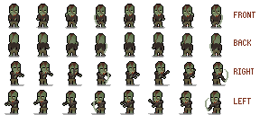
“The Whispers”
A game project by:
Archie Farrell - Creation of the repository, Asset Gathering, contributing to the coding of the game, Game Testing and Evidence
Charlie Glover - Base design of game/levels, Wiki contributions, contributing to the coding of the game
Natalie O’Callaghan - Design of the game/levels, creation of and updating the Wiki, contributing to the coding of the game
GitHub

Slide 2
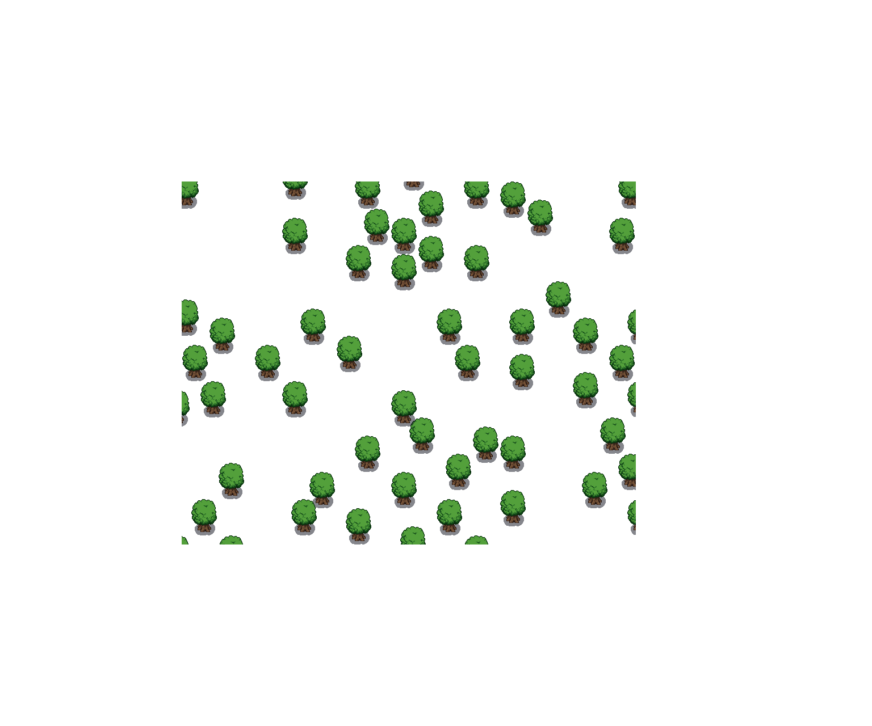
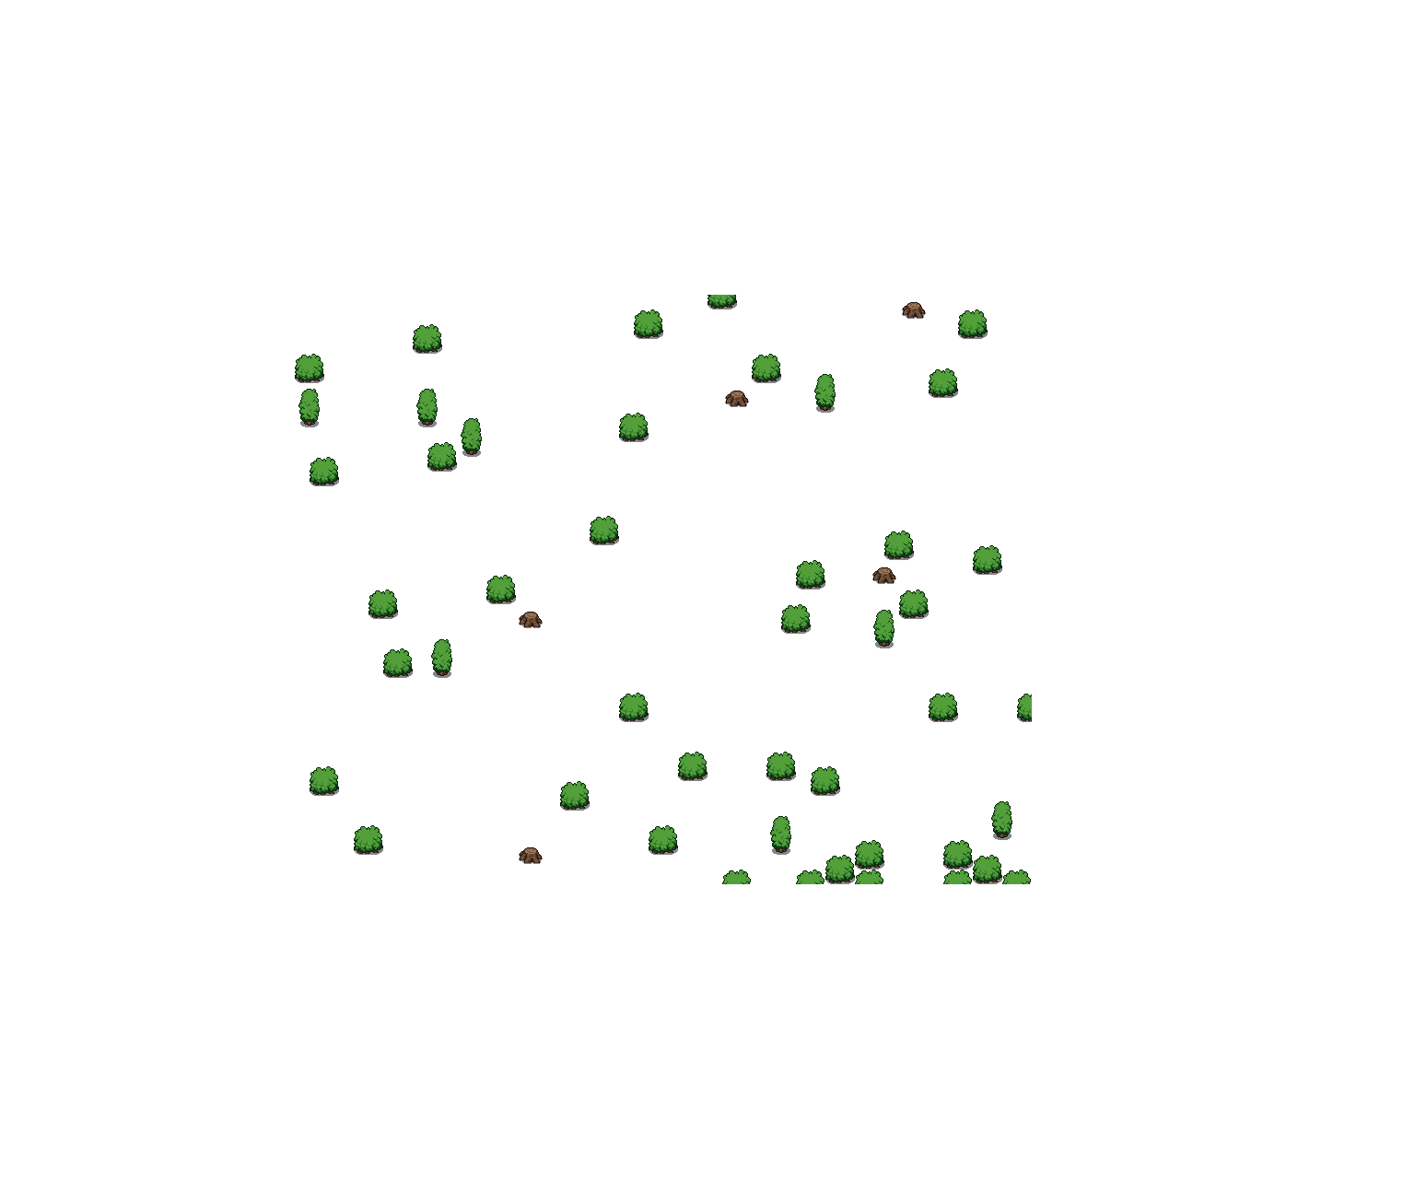
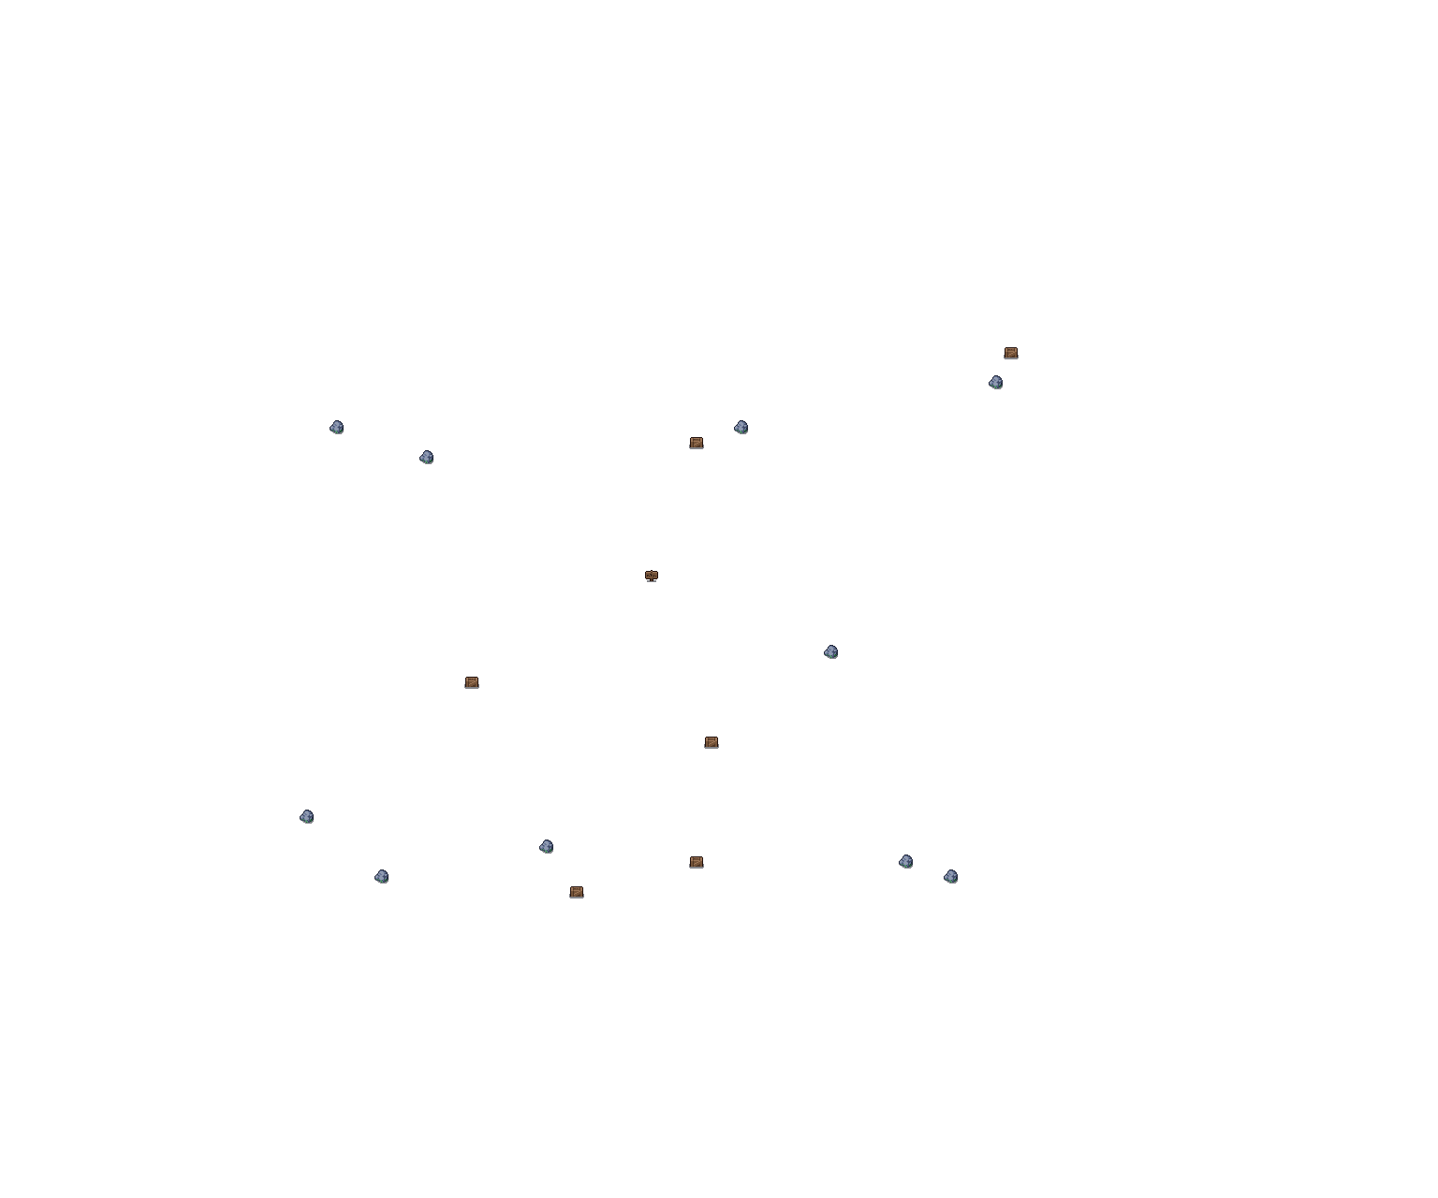
Introduction to the game
Storyline -
Frank (player character) approaches the forest in search of the long lost treasure after being lured in by whispers which lead to a broken down village (specifically a shop area) where there’s a shopkeeper still living and selling potions. Frank is then introduced to the forest and the idea of a dungeon by “Sven” (the shopkeeper).
Frank
Notes:
Storyline -
Frank (player character) approaches the forest in search of the long lost treasure after being lured in by whispers
Whispers lead to a broken down village / shop area where there is a shopkeeper still living
Shopkeeper remains selling potions ( been surviving there for ages )
Introduced to the forest and idea of the dungeon by “Sven” (the shopkeeper, who is Steven’s brother)
After earning enough coins, Frank can purchase a key for the dungeon (shopkeeper’s reasoning being that “there's a lot of supposed gold in the dungeon” and basically wants a deposit value incase “anything goes wrong”)
Enter 2nd level / Dungeon - Boss battle (Steven)
After the boss is defeated, Frank will celebrate in an “ending cutscene” where it is revealed that Sven is Steven’s brother and set Frank up.
Main character(s) - Player (Frank), shopkeeper (Sven), boss (Steven)
Objective - The player’s objective is to get the treasure by accumulating enough coins/currency to purchase a key to enter a dungeon area.

Slide 3
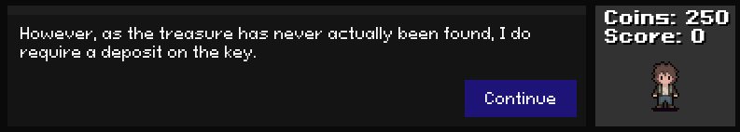
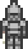
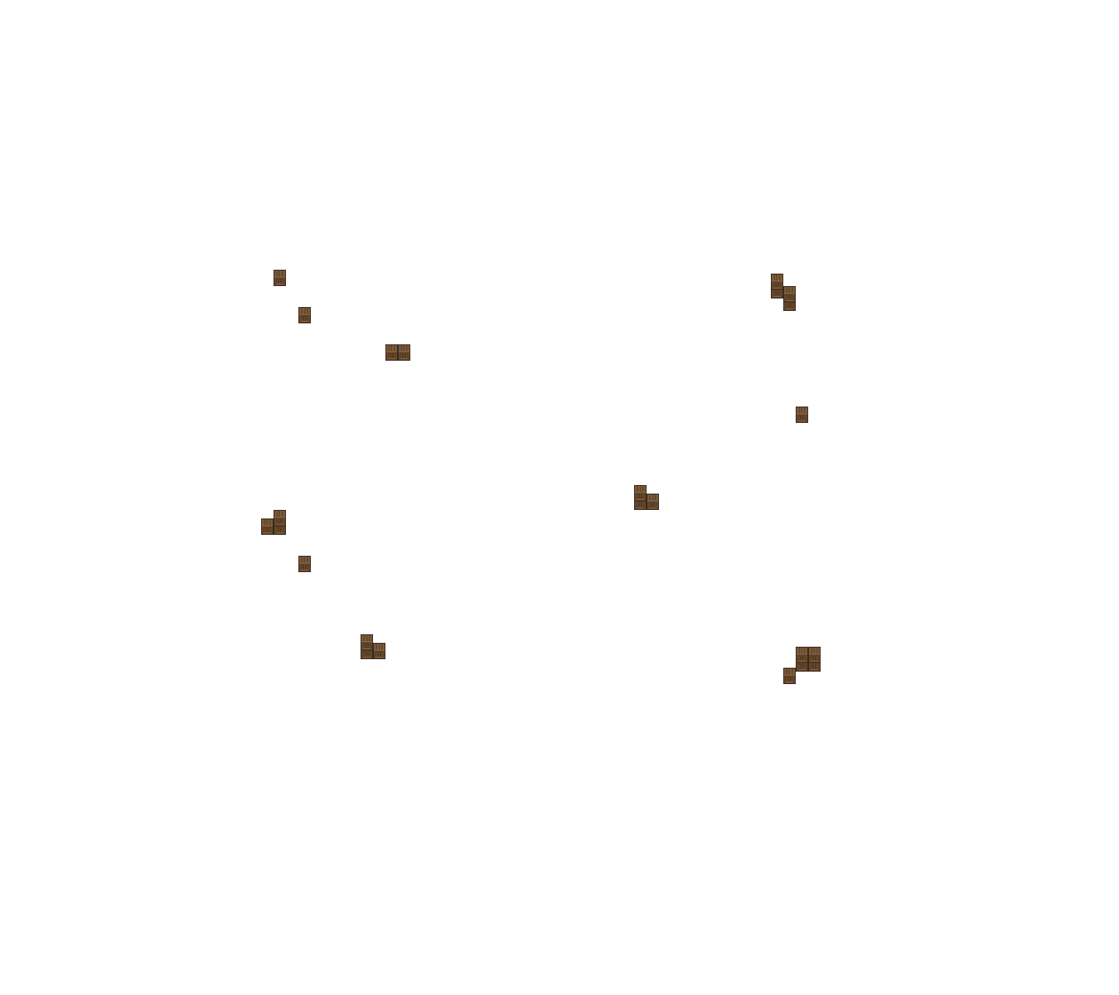
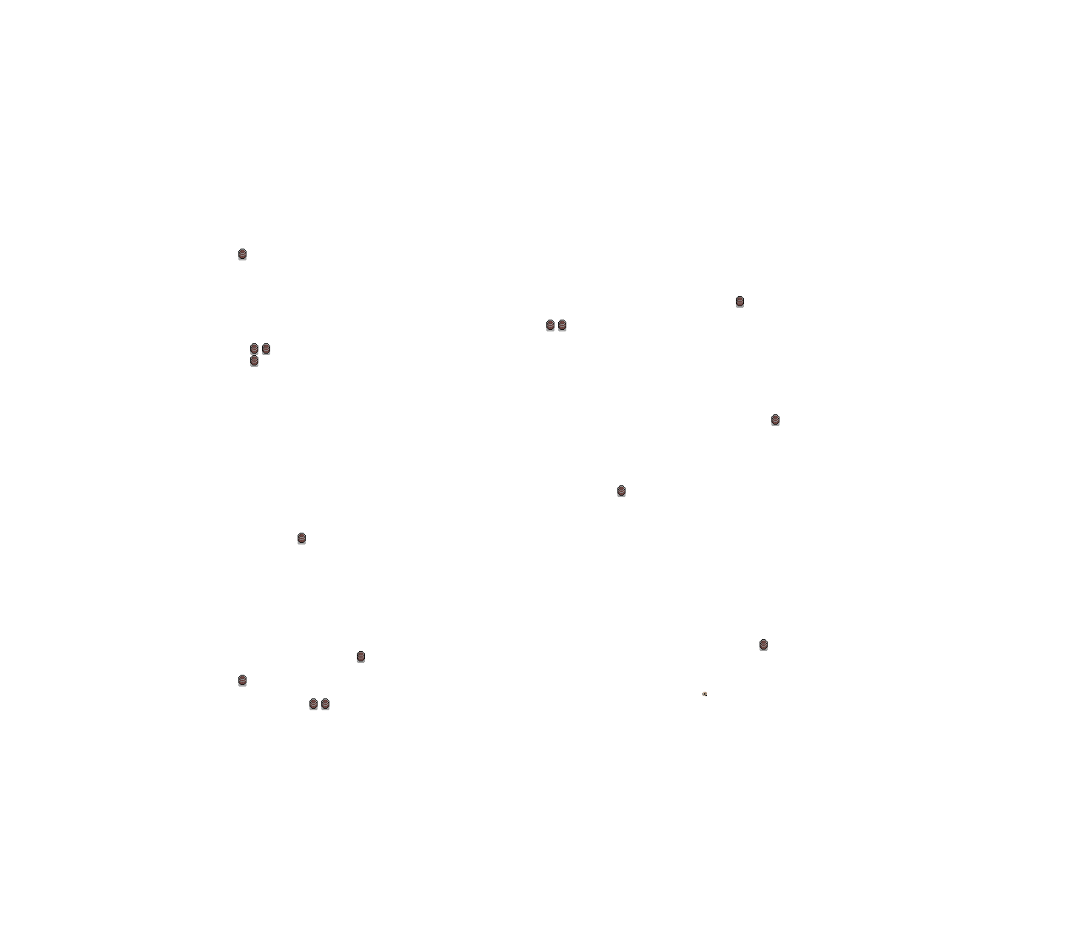
Introduction to the game
After earning enough coins, Frank can purchase a key for the dungeon (basically wants a deposit value incase “anything goes wrong”)
Sven
2nd level / Dungeon - Boss battle (Steven). After the boss is defeated, Frank will celebrate in an “ending cutscene” where it is revealed that Sven is Steven’s brother and set Frank up.
Steven
Notes:
Storyline -
Frank (player character) approaches the forest in search of the long lost treasure after being lured in by whispers
Whispers lead to a broken down village / shop area where there is a shopkeeper still living
Shopkeeper remains selling potions ( been surviving there for ages )
Introduced to the forest and idea of the dungeon by “Sven” (the shopkeeper, who is Steven’s brother)
After earning enough coins, Frank can purchase a key for the dungeon (shopkeeper’s reasoning being that “there's a lot of supposed gold in the dungeon” and basically wants a deposit value incase “anything goes wrong”)
Enter 2nd level / Dungeon - Boss battle (Steven)
After the boss is defeated, Frank will celebrate in an “ending cutscene” where it is revealed that Sven is Steven’s brother and set Frank up.
Main character(s) - Player (Frank), shopkeeper (Sven), boss (Steven)
Objective - The player’s objective is to get the treasure by accumulating enough coins/currency to purchase a key to enter a dungeon area.

Slide 4
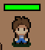
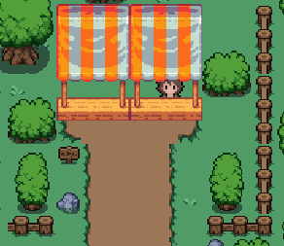
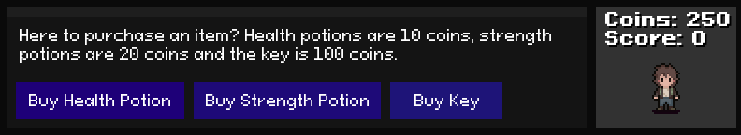
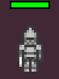
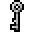
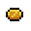
Introduction to the game
Characters -
Frank - The main player character.
Sven - The shopkeeper.
Steven - The boss of the game.
Objective -
Frank’s main objective is to get the treasure within the dungeon. This is done in-game after purchasing a key from the shopkeeper when enough coins have been collected.
Notes:
Storyline -
Frank (player character) approaches the forest in search of the long lost treasure after being lured in by whispers
Whispers lead to a broken down village / shop area where there is a shopkeeper still living
Shopkeeper remains selling potions ( been surviving there for ages )
Introduced to the forest and idea of the dungeon by “Sven” (the shop keeper, who is Steven’s brother)
After earning enough coins, Frank can purchase a key for the dungeon (shopkeeper’s reasoning being that “there's a lot of supposed gold in the dungeon” and basically wants a deposit value incase “anything goes wrong”)
Enter 2nd level / Dungeon - Boss battle (Steven)
After the boss is defeated, Frank will celebrate in an “ending cutscene” where it is revealed that Sven is Steven’s brother and set Frank up.
Main character(s) - Player (Frank), shopkeeper (Sven), boss (Steven)
Objective - The player’s objective is to get the treasure by accumulating enough coins/currency to purchase a key to enter a dungeon area.

Slide 5
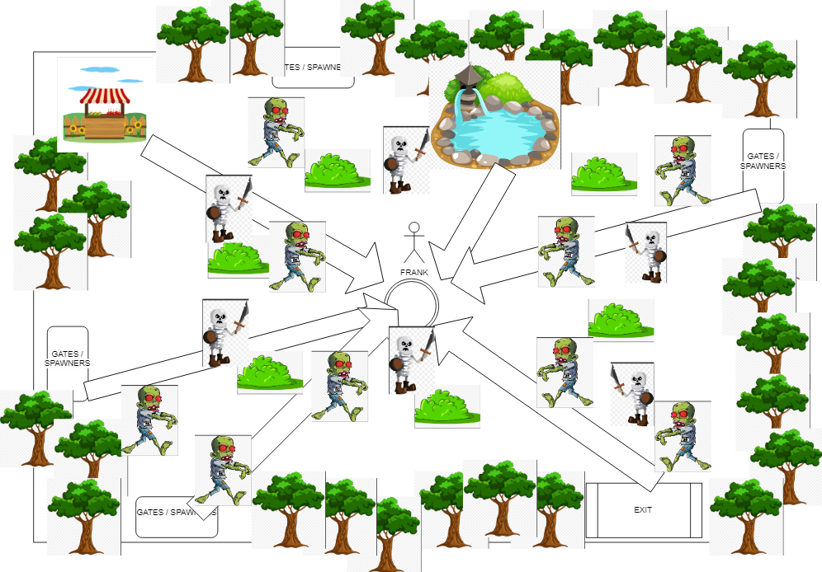
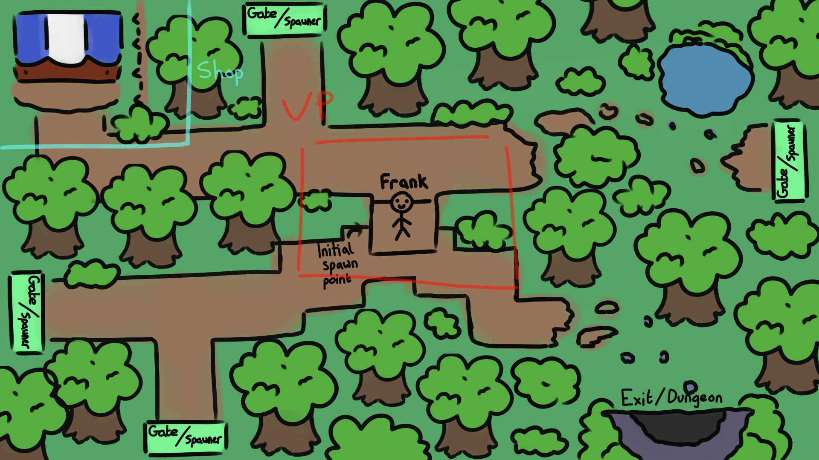
Design Considerations
Preparation before coding -
Before coding, assets were gathered, a planning document was made and designs were created for the first level
Notes:
Before coding, assets were gathered, a planning document was made and designs were created for the first level
Classes that were identified:
Main - This would just be the main file for the game where it will run.
Player - Will store information about the player and assists with breaking down the code a bit. The player will have an x and y value and then a strength and coin counter.
Enemy - Will allow for multiple instances of an enemy to be made and can allow for a “boss” to be made for the second level. Enemies will have an x and y value and a speed and health counter, they will also have a function that will allow for them to move towards the player.
Inventory - Structure for the inventory that the player will access and use. This will be made up of adding inventory slots into an array or list and placing these slots in places that match the way the inventory looks.
InventorySlot - Will provide individual slots within the inventory. An inventory slot will have a name and count so then it can be added or used from within the inventory.
HealthBar - A way to show the player’s current health. Will be a simple rectangle that changes colour depending upon how much health the player has left.
GUI / UserInterface - A simple user interface that will provide the user with some information (e.g the amount of coins they have) and assist with showing the inventory. This will have a way of updating so accurate information will be reflected to the player.
Item - Will be used for creating multiple instances of an item or currency for the game. Depending upon how difficult these are to implement, may just add a value to a counter or might “drop” an item that the player can pick up.

Slide 6
Design Considerations
Classes identified, key attributes and behaviours -
Main - Main file for the game where it will run.
Player - Will store information about the player. The player will have an x and y value and then a strength, score and coin counter.
Enemy - Allows for multiple instances to be made. They will have an x and y value, a speed and health counter and a function that will allow for them to move towards the player.
Coin - Will be used for creating multiple instances of an item or currency for the game.
Notes:
Before coding, assets were gathered, a planning document was made and designs were created for the first level
Classes that were identified:
Main - This would just be the main file for the game where it will run.
Player - Will store information about the player and assists with breaking down the code a bit. The player will have an x and y value and then a strength and coin counter.
Enemy - Will allow for multiple instances of an enemy to be made and can allow for a “boss” to be made for the second level. Enemies will have an x and y value and a speed and health counter, they will also have a function that will allow for them to move towards the player.
Inventory - Structure for the inventory that the player will access and use. This will be made up of adding inventory slots into an array or list and placing these slots in places that match the way the inventory looks.
InventorySlot - Will provide individual slots within the inventory. An inventory slot will have a name and count so then it can be added or used from within the inventory.
HealthBar - A way to show the player’s current health. Will be a simple rectangle that changes colour depending upon how much health the player has left.
GUI / UserInterface - A simple user interface that will provide the user with some information (e.g the amount of coins they have) and assist with showing the inventory. This will have a way of updating so accurate information will be reflected to the player.
Coin - Will be used for creating multiple instances of an item or currency for the game. Depending upon how difficult these are to implement, may just add a value to a counter or might “drop” an item that the player can pick up.

Slide 7
Design Considerations
Classes identified, key attributes and behaviours -
Inventory - Structure for the inventory that the player will access and use, made up of inventory slots in an array.
InventorySlot - Will provide individual slots within the inventory. An inventory slot will have a name and count so then it can be added or used from within the inventory.
HealthBar - A way to show the player’s current health. Will be a simple rectangle that changes colour depending upon how much health the player has left.
GUI - A simple user interface that will provide the user with some information (e.g the amount of coins they have) and assist with showing the inventory. This will have a way of updating so accurate information will be reflected to the player.
Notes:
Before coding, assets were gathered, a planning document was made and designs were created for the first level
Classes that were identified:
Main - This would just be the main file for the game where it will run.
Player - Will store information about the player and assists with breaking down the code a bit. The player will have an x and y value and then a strength and coin counter.
Enemy - Will allow for multiple instances of an enemy to be made and can allow for a “boss” to be made for the second level. Enemies will have an x and y value and a speed and health counter, they will also have a function that will allow for them to move towards the player.
Inventory - Structure for the inventory that the player will access and use. This will be made up of adding inventory slots into an array or list and placing these slots in places that match the way the inventory looks.
InventorySlot - Will provide individual slots within the inventory. An inventory slot will have a name and count so then it can be added or used from within the inventory.
HealthBar - A way to show the player’s current health. Will be a simple rectangle that changes colour depending upon how much health the player has left.
GUI / UserInterface - A simple user interface that will provide the user with some information (e.g the amount of coins they have) and assist with showing the inventory. This will have a way of updating so accurate information will be reflected to the player.
Coin - Will be used for creating multiple instances of an item or currency for the game. Depending upon how difficult these are to implement, may just add a value to a counter or might “drop” an item that the player can pick up.

Slide 8
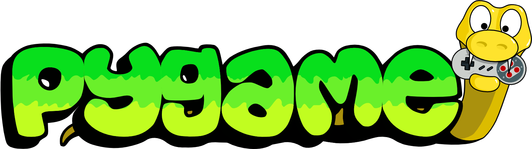
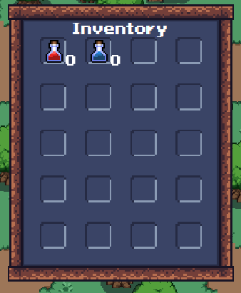
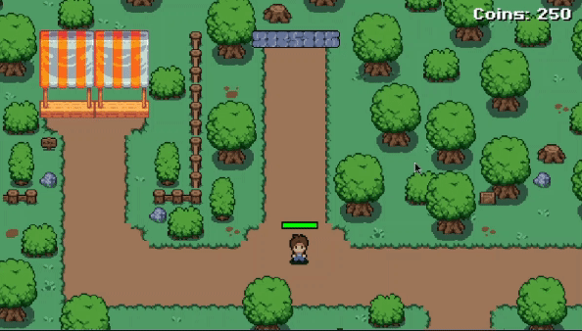
Development of the game
Issues we encountered -
Since this was the first time working with PyGame for all of the team, we ended up running into some issues over the course of development. For example:
Integrating the user interface, inventory, inventory slots and main.
Implementing the coin counter as it took a while to figure out how to get it to update whenever the coin count updates.
Getting the enemy waves to properly account for the amount of time that passed since the last enemy of the previous wave was defeated.
Getting the player attack to function properly and its animation to display as intended / refining combat.
Notes:
Since this was the first time working with PyGame for all of the team, we ended up running into some issues over the course of development.
Getting the player attack to function properly and its animation to display as intended / refining combat. Updating the array that handles the spritesheet frames and animations fixed this issue.
Issues with integrating the user interface, inventory, inventory slots and main.
Issues with implementing the coin counter as it took a while to figure out how to get it to update whenever the coin count updates. For example, when first implemented alongside the shop, when a player was making a purchase the coins would be depleted from their coin value but the text reflecting this value was not updating.
Getting the enemy waves to properly account for the amount of time that passed since the last enemy of the previous wave was defeated. Before changes, the timer was basing itself off of when the wave started so it would end up starting a new wave almost instantly based upon how quickly all enemies were defeated.

Slide 9
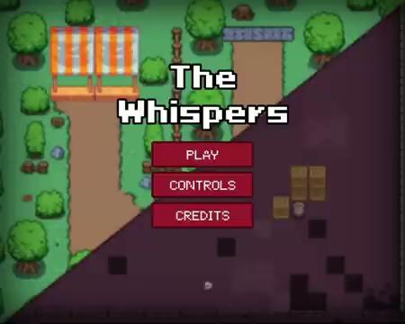
Demonstration of gameplay - Game Walkthrough
https://natbag.itch.io/the-whispers - password for the page is “CO452-PR1”

Slide 10
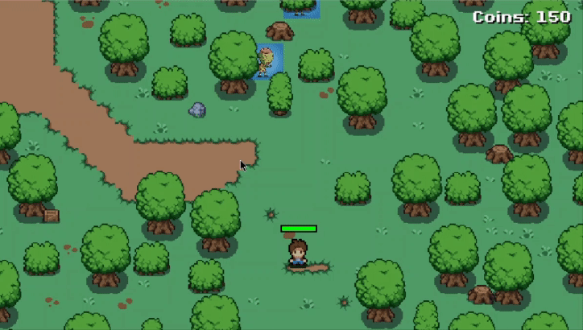
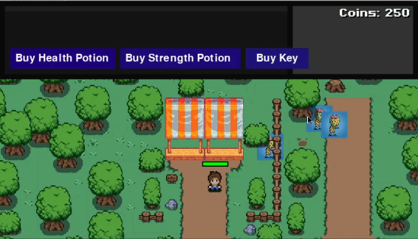
Demonstration of gameplay - Testing
Testing was carried out throughout different stages of the game’s development and recorded on the GitHub Wiki. The extent of testing can be seen on that page. Below are some examples of this testing.
Shop Functionality
Player animations
Level 2 Access

Slide 11
Evaluation
Lessons learnt -
Learnt how to collaboratively work on a game project.
Learnt a lot about pygame in general.
Effective planning from the beginning.
Improvements for next time -
Further optimise the game so it can run smoother.
Could make the game suitable for multiple devices.
Ensure that finalised / specific planning is done a bit earlier in the project timeline.
Notes:
Lessons learnt -
Learnt how to collaboratively work on a game project -
The team successfully demonstrated the ability to work collaboratively on the game. Effective collaboration is crucial for the success of any project, and it's commendable that the team was able to navigate through the complexities of working together.
Learnt a lot about pygame in general -
The team members actively engaged in learning about Pygame, showcasing a commitment to acquiring new skills and knowledge. This is essential for the growth of individuals and the overall success of the project.
Effective Planning -
The team's proactive approach to planning contributed significantly to the positive progress of the project. Being on top of planning ensures that goals are set, tasks are well-defined, and there's a clear roadmap for the project's development. In the First week the Team sat down and went through Assets and created a checklist and gave Dates when certain aspects needed to be completed.
Improvements for next time -
Further optimise the game so it can run smoother -
We’re currently running the game in Repl.it. This allows us to collaborate in real time and push all updates to GitHub. The issue with Repl.it is that the free version is limited with processing power and Memory. We decided to move the game to VS code for our presentation and testing.
Could make the game suitable for multiple devices (e.g implementing controls for mobile) -
To make the game more accessible to people who may not have access to a computer / laptop or would prefer playing a game like this on a phone.
Ensure that finalised / specific planning is done a bit earlier in the project timeline as it really helped with getting the game on track and keeping the whole team up to date with the progress -
When Making our pre planning document as seen in the first section. It would have been beneficial to create the checklist with all the tasks that needed doing at the beginning. Instead we kept adding things and not keeping track which we discovered caused issues between us. So we created a checklist and worked through it.
Conclusion -
In Conclusion, we successfully worked as a team to complete the game along with our presentation and wiki. We learnt Pygame a new language none of us have used in the past. We Successfully managed our time correctly and completing all tasks within the given time frame. In future we could plan tasks sooner and not dive straight into creating the game. All in all we are very happy with the product we have created.

